Slide 1
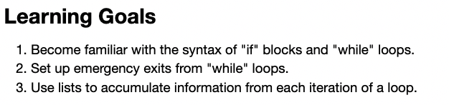
Recap: Little CGI learning goals

Slide 2
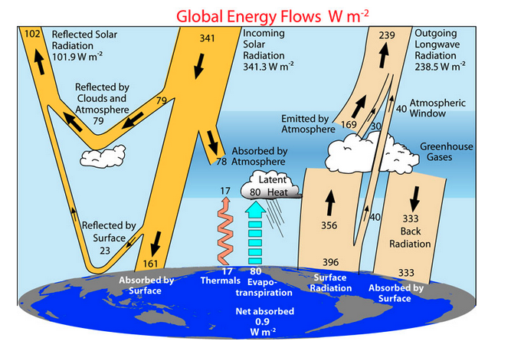
Radiative balance

Slide 3
Radiative balance
OLR = Outgoing Longwave Radiation (outgoing energy)
far-IR, microwave
ASR = Absorbed Shortwave Radiation (incoming energy)
visible, ultraviolet, near-infrared

Slide 4
Radiative balance
OLR = Outgoing Longwave Radiation (outgoing energy)
far-IR, microwave
Basic algorithm:
If ASR > OLR, Earth will heat up
If ASR < OLR, Earth will cool down
ASR = Absorbed Shortwave Radiation (incoming energy)
visible, ultraviolet, near-infrared

Slide 5

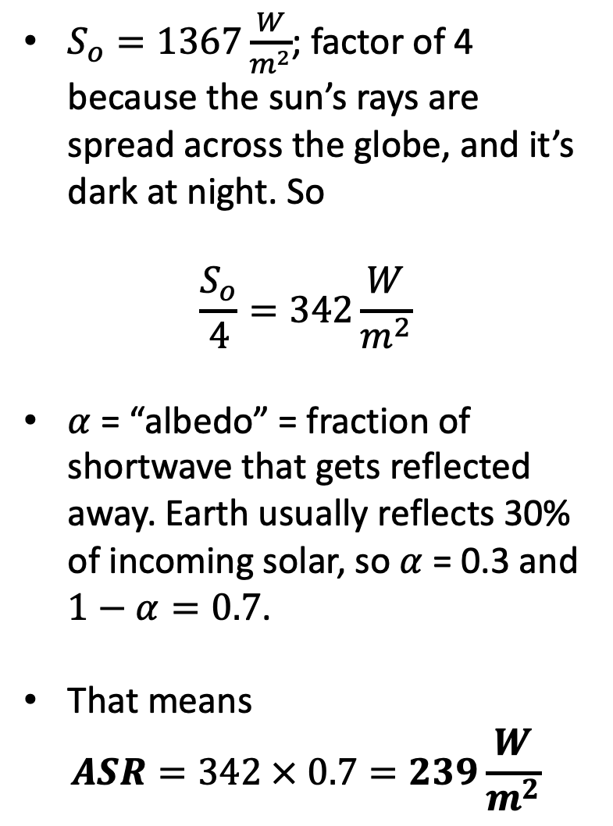
Shortwave
$S_{o}=1367\frac{W}{m^{2}}$; factor of 4 because the sun’s rays are spread across the globe, and it’s dark at night. So
$$\frac{S_{o}}{4}=342\frac{W}{m^{2}}$$
$α$ = “albedo” = fraction of shortwave that gets reflected away. Earth usually reflects 30% of incoming solar, so $α$ = 0.3 and $1−α=0.7$.
That means
$$ASR=342 × 0.7=239\frac{W}{m^{2}}$$

Slide 6


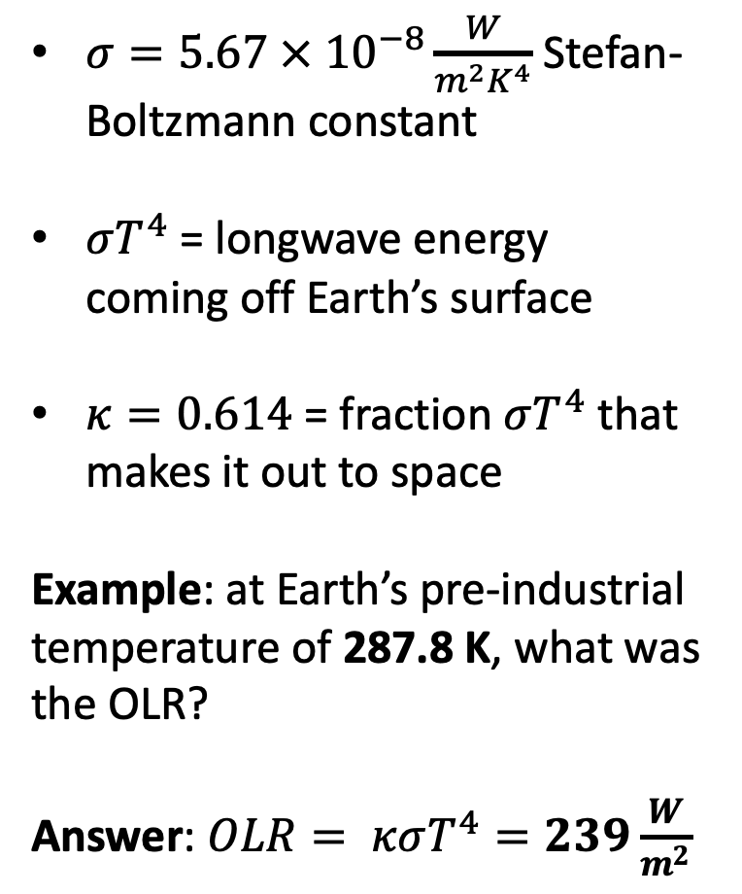
Longwave
$σ=5.67 × {10}^{−8}\frac{W}{m^{2}K^{4}}$ Stefan-Boltzmann constant
$σT^{4}$ = longwave energy coming off Earth’s surface
$κ=0.614$ = fraction $σT^{4}$ that makes it out to space
Example: at Earth’s pre-industrial temperature of 287.8 K, what was the OLR?
Answer: $OLR= κσT^{4}=239\frac{W}{m^{2}}$
*That’s 14.8 $℃$, or 58.6 $℉$

Slide 7

Longwave
$σ=5.67 × {10}^{−8}\frac{W}{m^{2}K^{4}}$ Stefan-Boltzmann constant
$σT^{4}$ = longwave energy coming off Earth’s surface
$κ=0.614$ = fraction $σT^{4}$ that makes it out to space
Example: at Earth’s pre-industrial temperature of 287.8 K, what was the OLR?
Answer: $OLR= κσT^{4}=239\frac{W}{m^{2}}$
$$239=239$$
$$ASR=OLR$$
Radiative balance!

Slide 8

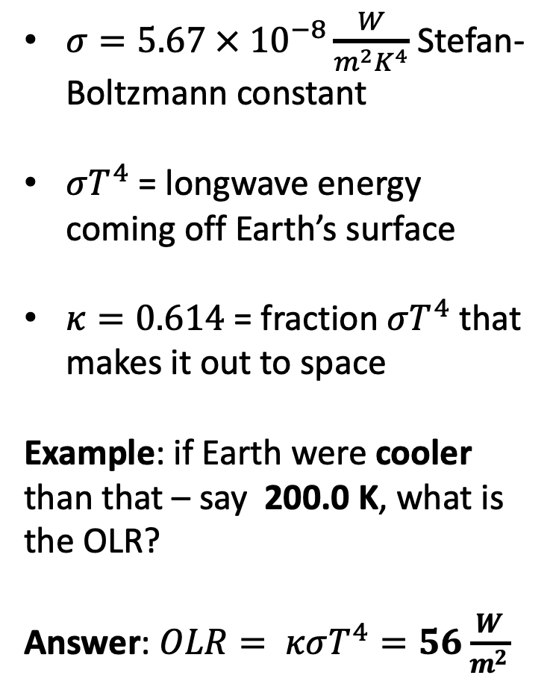
Longwave
$σ=5.67 × {10}^{−8}\frac{W}{m^{2}K^{4}}$ Stefan-Boltzmann constant
$σT^{4}$ = longwave energy coming off Earth’s surface
$κ=0.614$ = fraction $σT^{4}$ that makes it out to space
Example: if Earth were cooler than that – say 200.0 K, what is the OLR?
Answer: $OLR= κσT^{4}=56\frac{W}{m^{2}}$
$$239>56$$
$$ASR>OLR$$
We’re not in radiative balance!

Slide 9

Basic “Simple Radiative Balance” (SRB) algorithm
If ASR > OLR, Earth will heat up
If ASR < OLR, Earth will cool down

Slide 10
Basic algorithm
If ASR > OLR, Earth will heat up
If ASR < OLR, Earth will cool down
Time step
Let’s look at the code …

Slide 11
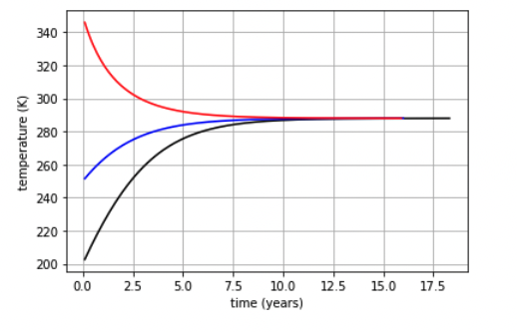
Results
Goldilocks: Temperature at which ASR = OLR

Slide 12
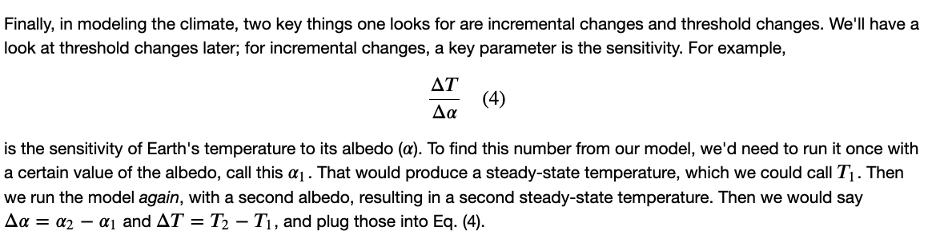
Climate sensitivity
Lower albedo or higher?

